Slide 1
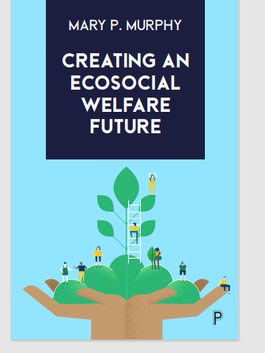
Mary P Murphy,
Department of Sociology,
Maynooth University
Email: mary.p.murphy@mu.ie
Murphy MP (2023) Creating an Ecosocial Welfare Future, Bristol, Policy Press

Slide 2
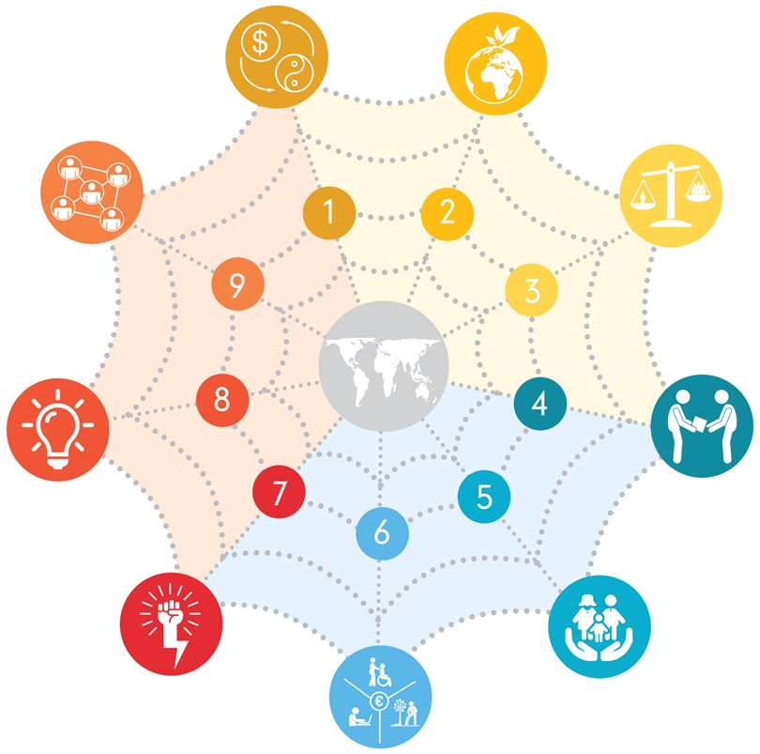
PART ONE chs 1,2,3 From problems to solutions: a post-growth eco-social political economy PART TWO chs 4,5,6, Reimaging Welfare: building an eco-social imaginary PART THREE chs 7,8,9, Making it happen: An eco-social political imaginary

Slide 3
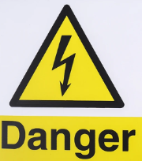
Introduction What and Why
Introduction: The case for a welfare imagination
Personal investment - political imagination and hope
Taking risks – no ‘same old’
Aim to prompt discussion - Feedback welcome
Eco-social welfare
Ireland as an anchor case

Slide 4
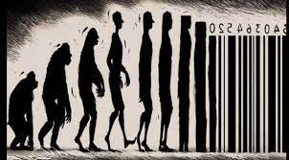
PART ONE From problems to solutions: a post-growth eco-social political economy
Commodification and decommodification
From unsustainable environmental outcomes to a post-growth world
Excessive wealth + excessive consumption
From an unequal society to eco-social welfare

Slide 5
Commodification and decommodification
Capitalism and neoliberalism
Commodification and decommodification
The Irish political economy – a commodified state

Slide 6
From unsustainable environmental outcomes to a post-growth world
How bad is environmental degradation?
Situating arguments within the politics of economic growth
Ireland’s record on the environment

Slide 7
From an unequal society to eco-social welfare
Social inequality
Welfare not working –
Reimagining social protection as eco-social welfare
Social Inequality in Ireland

Slide 8
– Social inequality and carbon emissions
Global
Top 1% 110 tonnes
(9.5% 1990 – 12% 2020)
Top 10% 30 tonnes
Bottom 50% ? Tonnes
Nearly at 2030 target
Ireland
1%- 61 tonnes
Bottom 50% X tonnes
97% v 40% reduction
To reach 2 tonnes by 2020

Slide 9
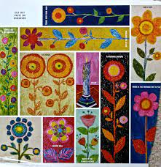
PART TWO Reimaging Welfare: building an eco-social imaginary from pockets of the future in the present:
Reciprocity, interdependence, enabling institutions
Universal Basic Services (UBS)
Participation Income (PI)

Slide 10
Reciprocity and interdependence: enabling institutions
Start with what we want
Values: reciprocity, collective freedoms, well being, sustainability
Building welfare Institutions
Seeds of the future: Ireland’s welfare institutions

Slide 11
Ch 5: Universal Basic Services-
Arguments for UBS, can meet collective need
UBS, the practice, regulation
Seeds of the future: UBS Care in Ireland?

Slide 12
Ch 6: Participation Income
An income support to complement UBS
Seven arguments underpinning the case for Participation Income
Seeds of the future: An Irish PI (artists basic income prompting new demands, carers?)

Slide 13
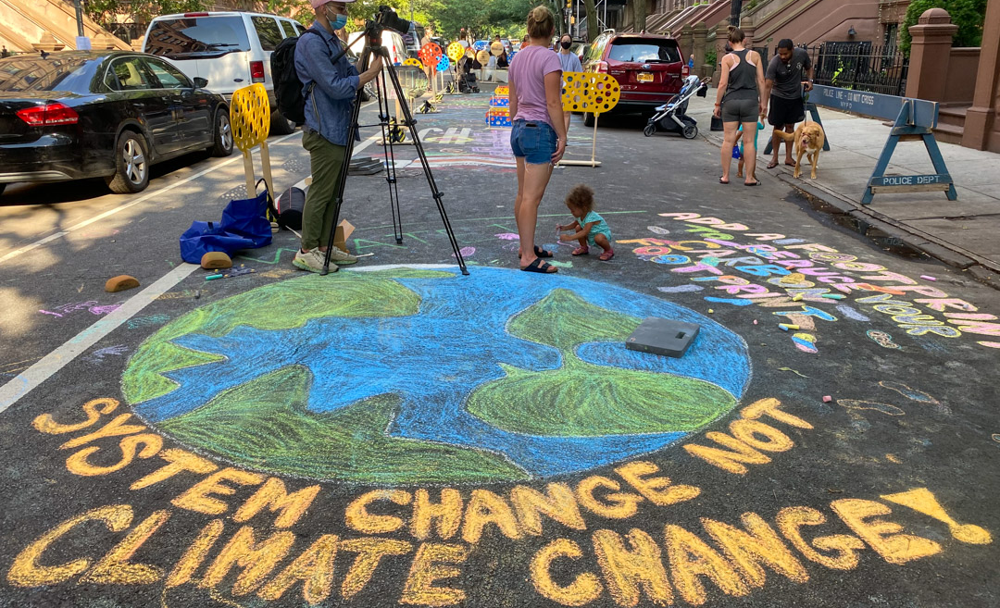
PART THREE Making it happen: An eco-social political imaginary
Power and Mobilisation
Imaginaries and ideas
Achieving change through high-energy democracy and coalition-building

Slide 14
Power and mobilisation
Power and Transformation – how change happens – demand for change?
Mobilisation as Inclusive Participation
Ireland: power and transformation

Slide 15
Imaginaries and ideas
Imagination and ideas prompting demand for change. Ready Now?
Framing narratives
Irish imagination- transformation through values in recent referenda

Slide 16
Achieving change through high-energy democracy and coalition-building
Structure: Contesting capital through high-energy democracy – making democracy work for people
Agency: coalition-building and triple movements
Ireland – joining the dots for eco-social policy

Slide 17
The future of welfare is eco-social: making it happen
Conclusion
Restating the urgent problems and solutions
Strategy: contesting power and joining the dots
Crisis only and opportunity is ready - READY NOW…

Slide 18
New welfare imaginary, Island of Ireland, N and S
Ireland, north and south, significant transition
Potential constitutional change, social and economic transitions associated with climate change, automation, digitalisation/AI.
Social policy to enable micro transitions across people’s life courses and meso level collective transitions of key institutions and policies.
Climate change responses require an interrelated focus on environmental sustainability and inequalies – different sides of same coin
Welfare/social policy can enable individual navigational agency, & new forms of paid and unpaid work -.

Slide 19
An alternative is possible
Present welfare activation oriented to maximising participation in paid employment.
New welfare imaginary to maximise participation in provision of social value and achieving key social and environmental goals (supporting care, ecological protection, democratic deliberation).
Income supports and public services to underpin all forms of participation and support our reciprocal interdependence and collective well-being and sustainability.
Participation Income (halfway house between contemporary conditional social security and an unconditional basic income), combined with universal basic services and enabling institutions (PES, ALMP, FET, CD)
Seeds for transformation in present policy.

